Slide 1
Big Data and Data-Drivenness
WQD7001

Slide 2
Learning Objective
To describe how the world has changed.
To illustrate the concept of “datafication”
To explain the phenomena of big data.
To determine the value of big data.
To summarize the strategy of data-driveness.

Slide 3

AND CONSTANTLY CHANGING

Slide 4
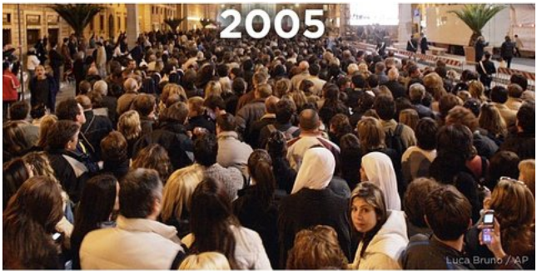
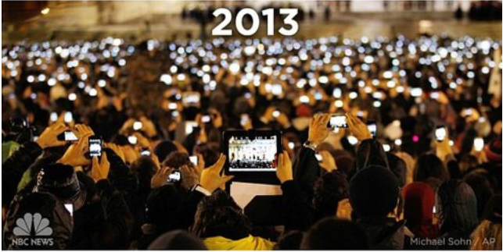

Slide 5

Emerging Age of Wisdom

Slide 6
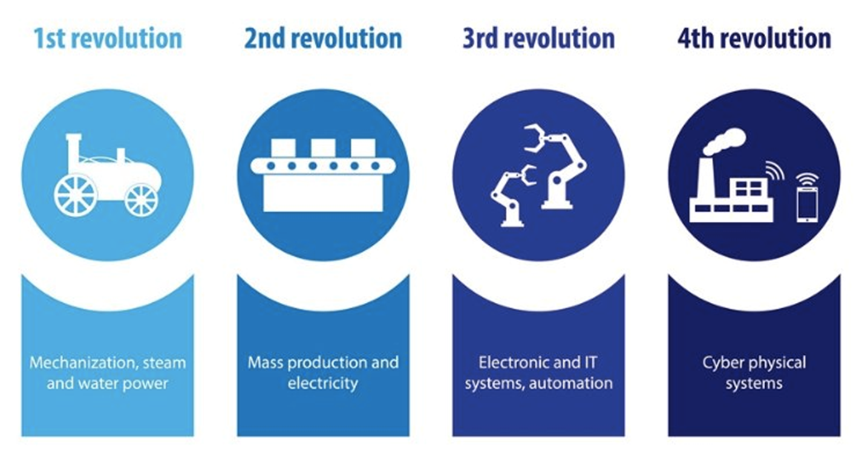

Slide 7
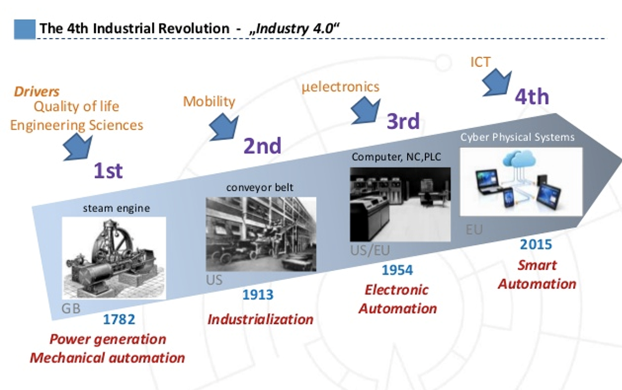

Slide 8
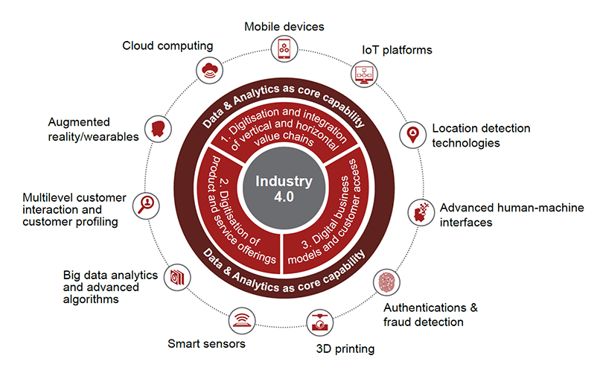
IR 4.0 – Making Sense of the Buzzword
The term "Industry 4.0", originates from a project in the high-tech strategy of the German government, which promotes the computerization of manufacturing.
3 differences between IR 4.0 and the
previous ones:
Speed – this revolution is upon us rapidly
Pervasiveness – it’s about mobile networks, sensors, nanotechnology, brain research, computing, networks, etc. being accessible
and affordable.
Entirety – it is creating the global shared economy.
https://www.thedualarity.com/industrial-revolution-4-0-2/

Slide 9
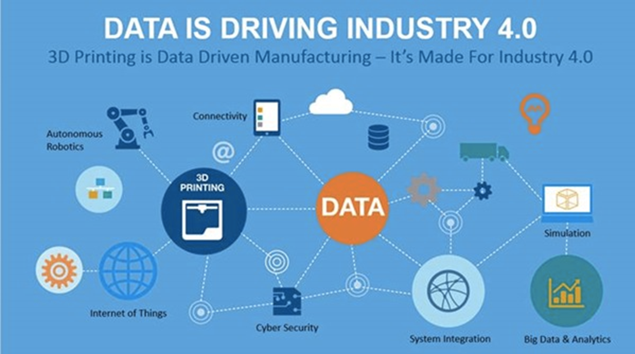

Slide 10
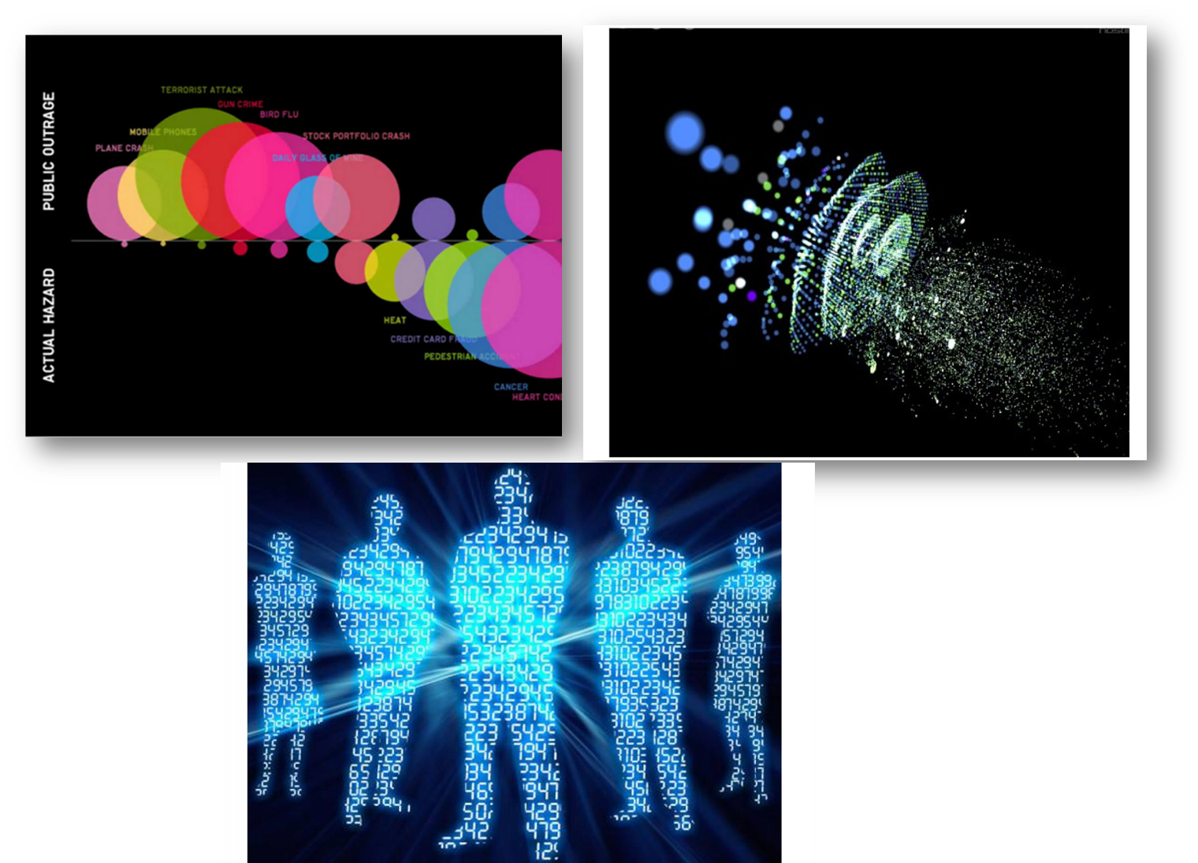
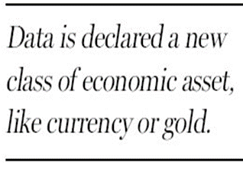
You can’t make more of time, you can only move faster or use it more wisely. Everyone expects instant access and immediate response!
DATA IS THE NEW CURRENCY

Slide 11

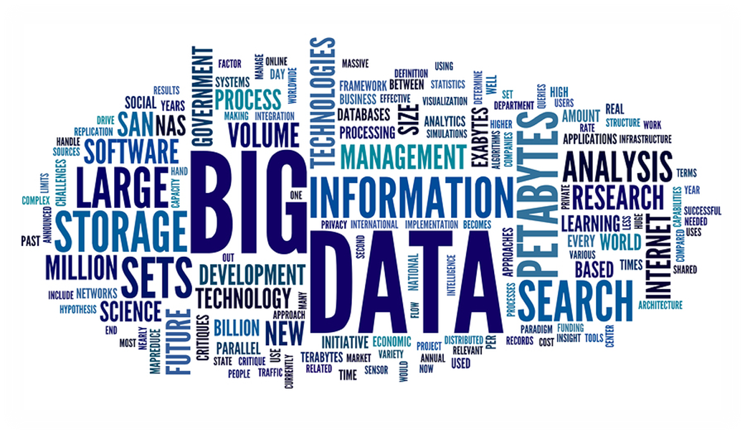
The Trigger - Data Explosion
Defining Big Data
Big Data as Research & Scientific Topic
Opportunities of Big Data
Challenges of Big Data

Slide 12
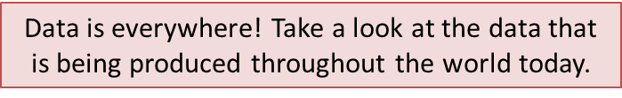
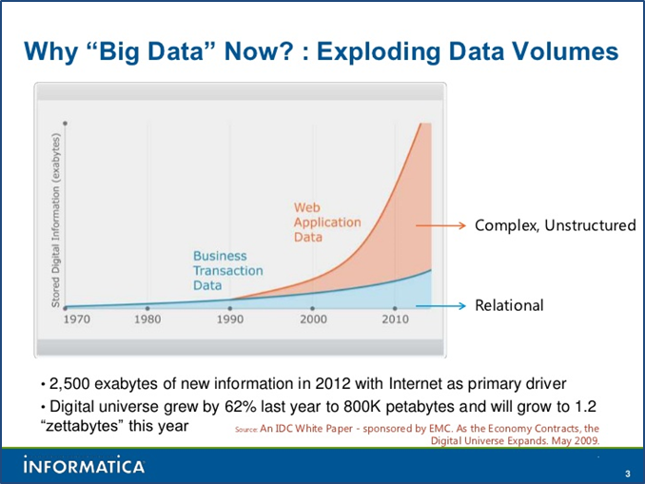
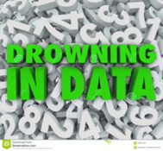
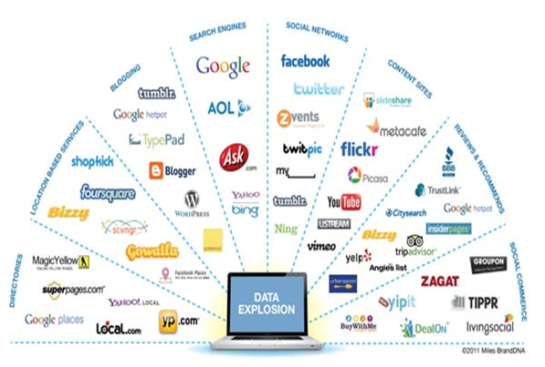

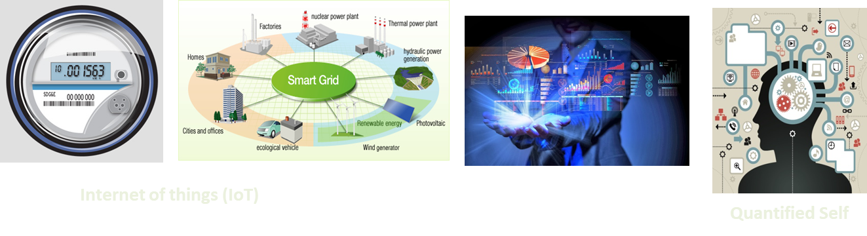
Data Explosion

Slide 13
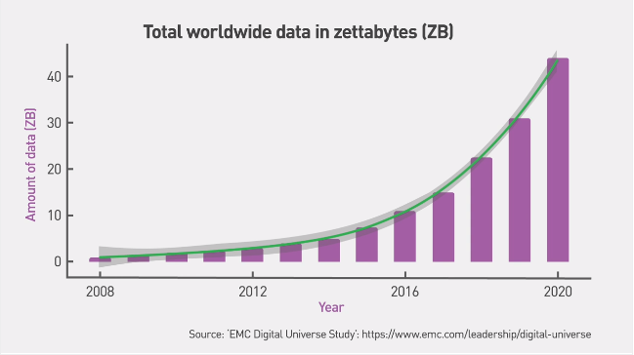
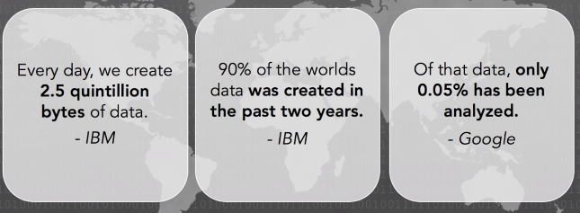
Exponential Growth

Slide 14
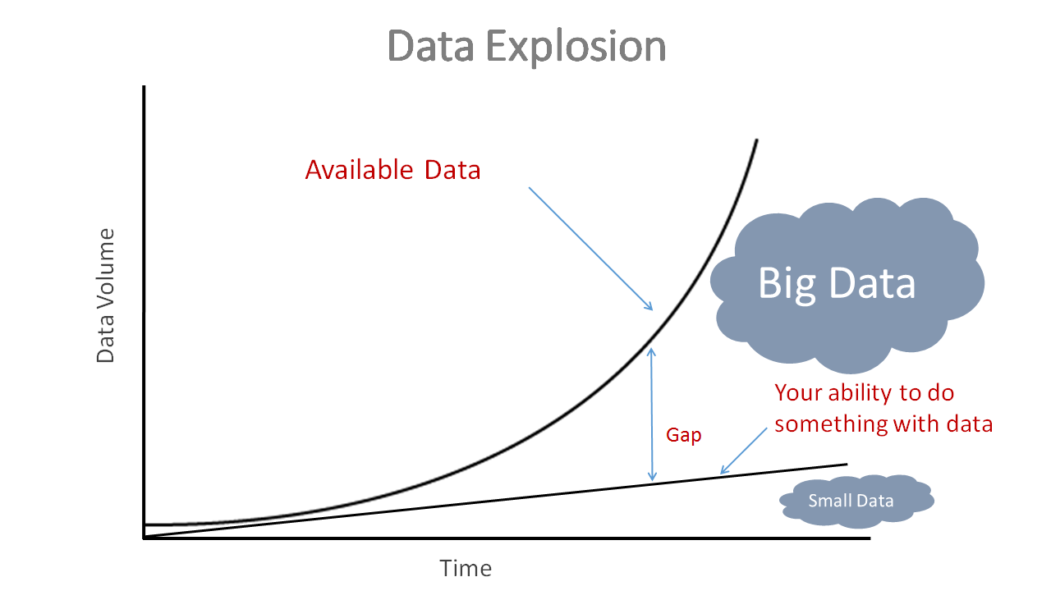
Two key consequences result:
Knowledge Gap: The difference between collecting data and understanding data
Execution Gap: The difference between understanding data and acting on it

Slide 15
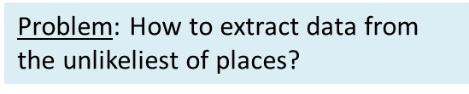
Datafication
The practice of turning numerous aspects of life into data and transforming it in order to create value.
How?
To put data in a quantified format so it can be tabulated and analyzed … Quantifying the world!
Why?
To improve critical processes
enables prediction & thus planning
can be fully tracked, monitored and optimized.

Slide 16

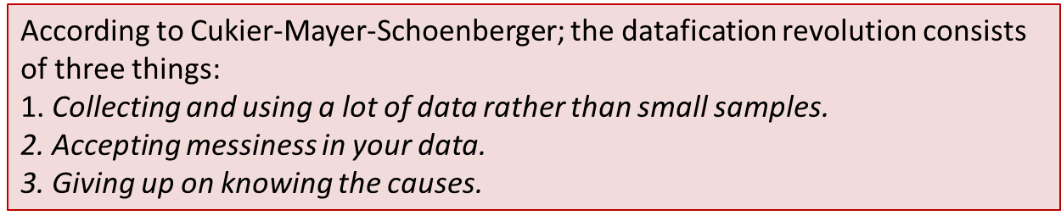
Datafication
Facebook has “datafied” our friend network.
Google has "datafied" our search and information retrieval.
LinkedIn has "datafied" our professional connections.
Twitter is "datafying" news and real time information.
Waze is "datafying" our driving.
GE is "datafying" all its engines, power plants, and machines.
Datafication is a resource and a tool. It is meant to inform, rather than explain; it points toward understanding.
https://www.youtube.com/watch?v=FUj9Ug5kGHM

Slide 17

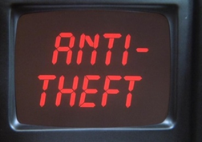
Datafication Example
A Japanese team convert backsides (posture – the way people sit) into data by measuring the pressure at 360 different points from sensors in a car seat and indexing each point on a scale from zero to 256.
The result is a digital code that is unique for each individual.
This system can distinguish drivers with 98% accuracy, and later this technology is being developed as an anti-theft device in cars by recognizing if the driver is the car owner.
Shigeomi Koshimizu, from the Advanced Institute of Industrial Technology in Tokyo, Japan

Slide 18
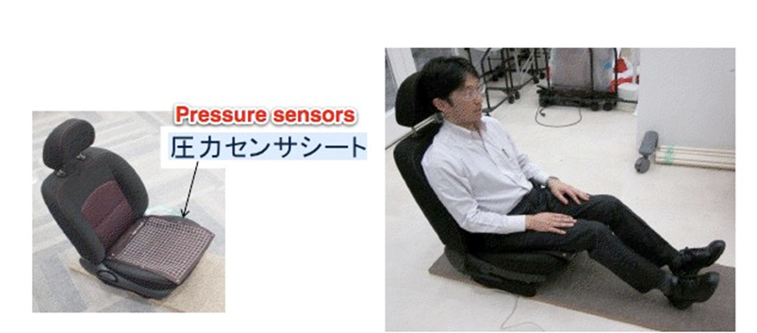
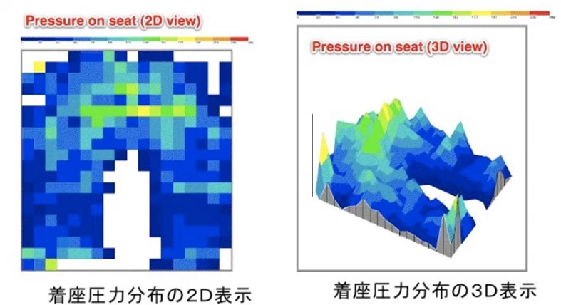
To Prevent Theft: Car Seat Identifies Drivers Sitting Down
The trick is that the system measures the pressure people apply on the seat through a set of 360 sensors.
Each sensor is measuring pressure by its own and sends the information to a laptop, which aggregates the information to show key data like the highest value of pressure, area of contact on the seat, and other factors.
https://techcrunch.com/2011/12/21/car-seat-japan/

Slide 19
The 7 ways you are totally unique
Ears
Body odour
Way you walk
Backside
Skull
Fingernails
Pores on your nose
http://www.bbc.com/future/story/20170109-the-seven-ways-you-are-totally-unique

Slide 20
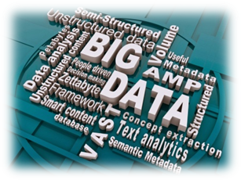
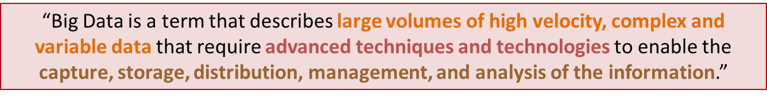
What is Big Data?
Big data is a phenomenon resulting from the rapid acceleration in the expanding volume of high velocity, complex, and diverse types of data.
No single standard definition.
Challenge: How to derive value through insight from an explosion of data at greater speed, scale and efficiency?
http://datascience.berkeley.edu/what-is-big-data/
Notes:
Big data essentially means datasets that are too large
for traditional data processing systems, and therefore require new processing technologies.

Slide 21
Big data is an umbrella term for datasets that cannot reasonably be handled by traditional computers or tools due to their volume, velocity, and variety.
This term is also typically applied to technologies and strategies to work with this type of data.

Slide 22
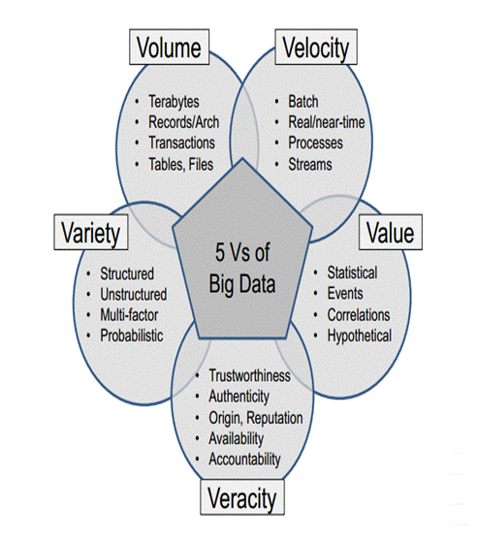
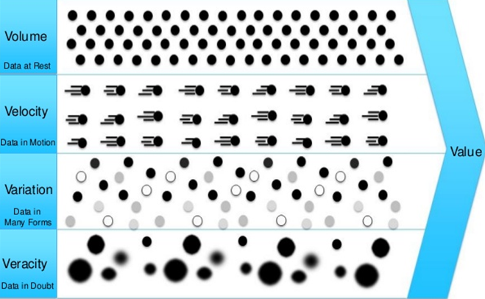
The Dimensions of Big Data – 5Vs
Volume: Large volumes of data.
Velocity: Quickly moving data.
Variety: structured, unstructured, images, etc.
Veracity: Trust and integrity is a challenge and a must and is important for big data just as for traditional relational DBs.
Value: generate transformative amazing value from big data.

Slide 23
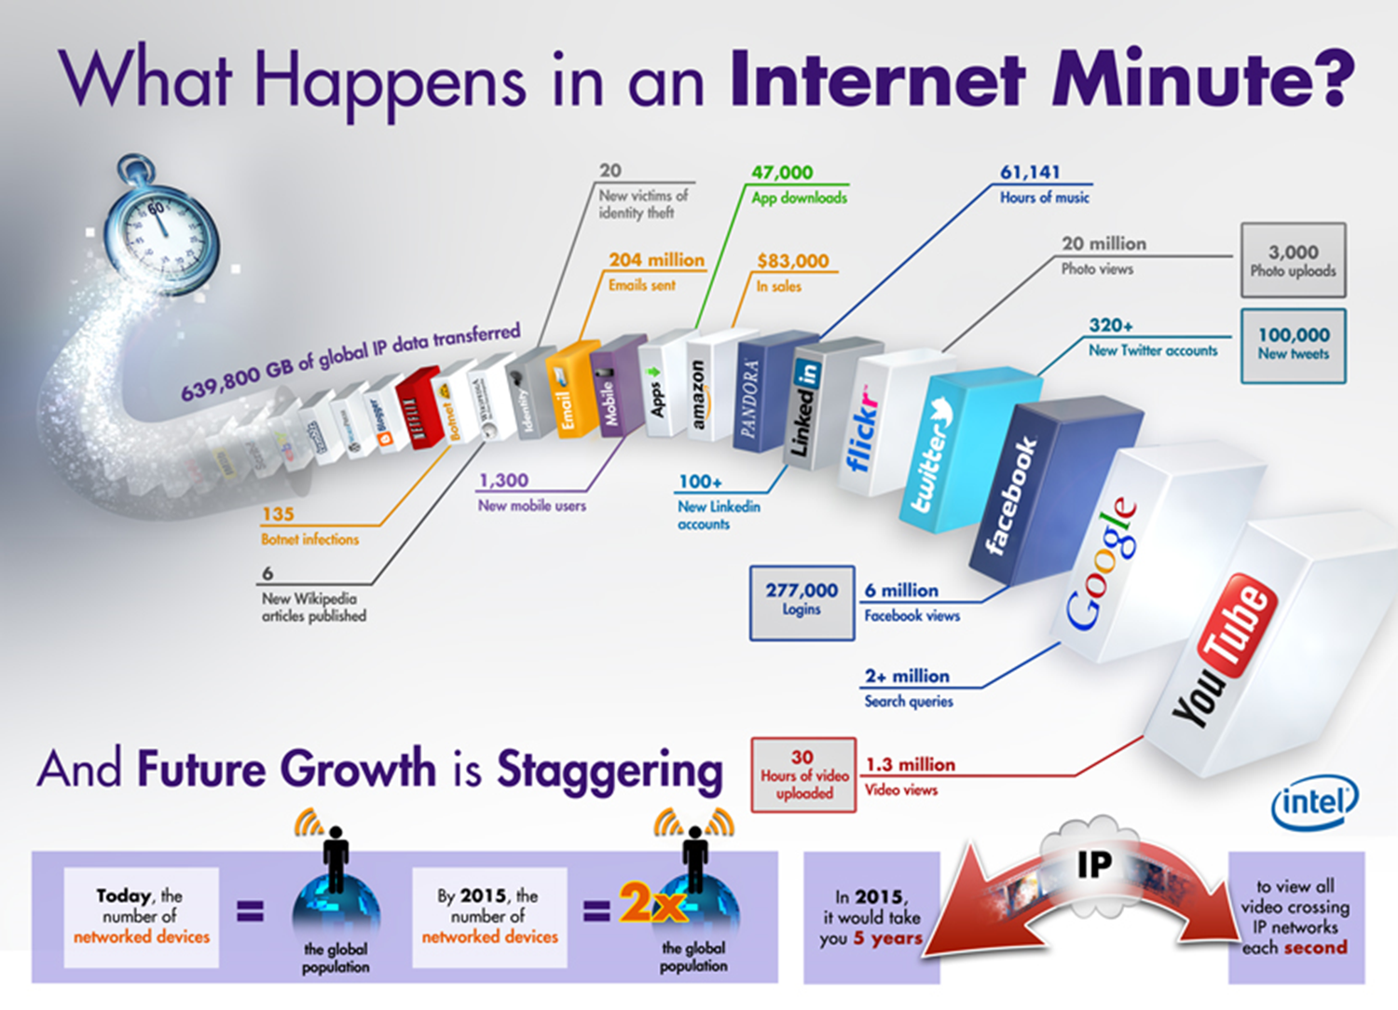
Source: http://www.intel.com/content/www/us/en/communications/internet-minute-infographic.html

Slide 24
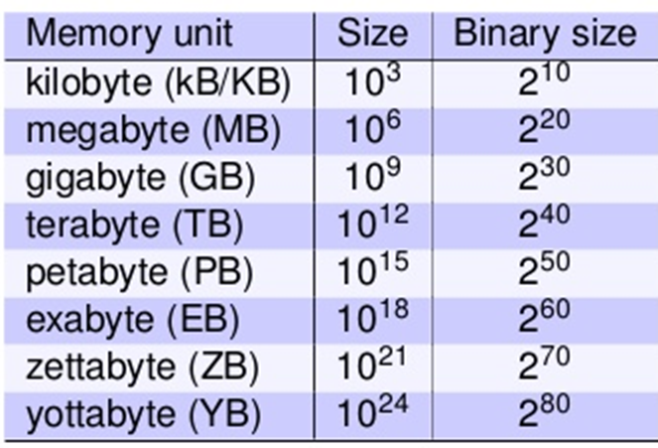
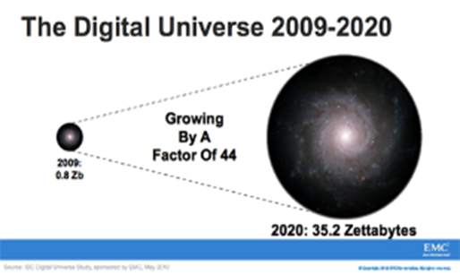
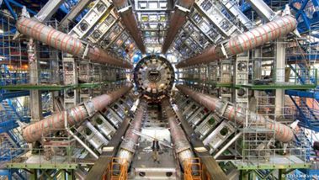
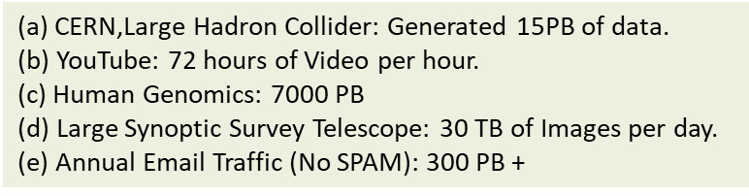

Volume - The Big Data Numbers
Data Volume
44x increase from 2009 to 2020
From 0.8 zettabytes to 35zb
Data volume is increasing exponentially.

Slide 25
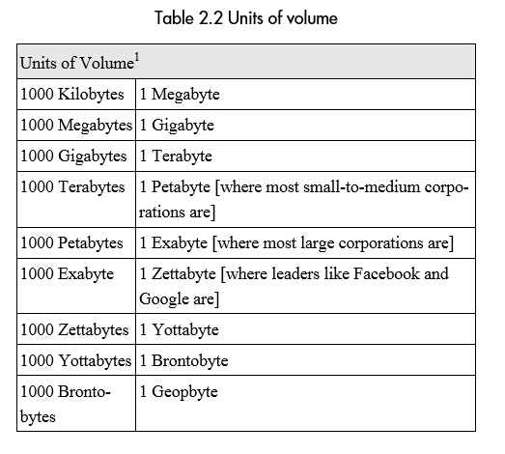

Slide 26

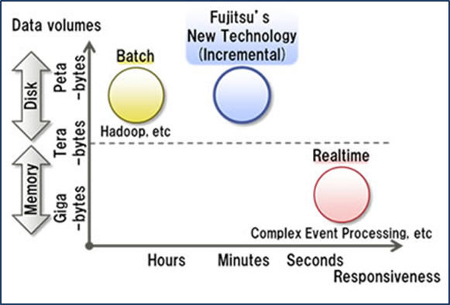
Velocity (Speed)
Data that is being generated fast, need to be processed fast.
Online Data Analytics
Late decisions → missing opportunities.
Examples
E-Promotions: Based on your current location, your purchase history, what you like → send promotions right now for store next to you.
Healthcare monitoring: sensors monitoring your activities and body → any abnormal measurements require immediate reaction.
Data on time - Accelerating time-to-value from data creation to data usage.

Slide 27
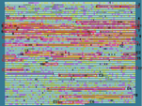

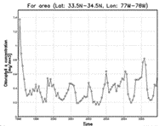
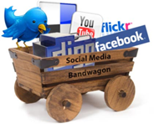
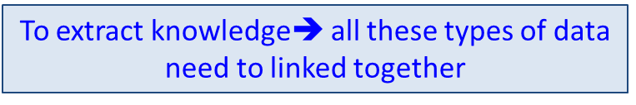
Variety of Data
Structured data – neatly organized in databases.
Could be translated into strings of ones and noughts capable of being recorded, stored, searched, and analysed.
Unstructured data - generated by all our digital interactions, from email to online shopping, text messages to tweets, Facebook updates to YouTube videos.
The number of gadgets recording and transmitting data, from smart-phones to intelligent fridges, industrial sensors to CCTV cameras, has proliferated globally, leading to an explosion in the volume of data.
These data sets are now so large and complex that we need new tools and approaches to make the most of them.
Data categories - social media; server logs; Web clickstream; machine/sensor; and geolocation

Slide 28


Slide 29
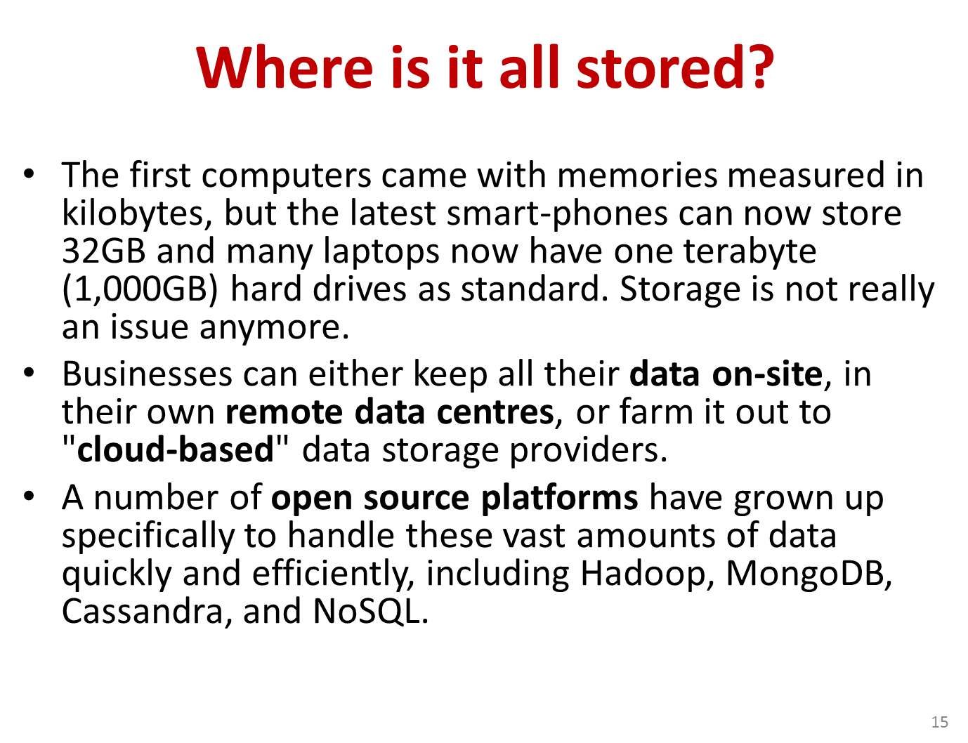
Where Is It All Stored?

Slide 30
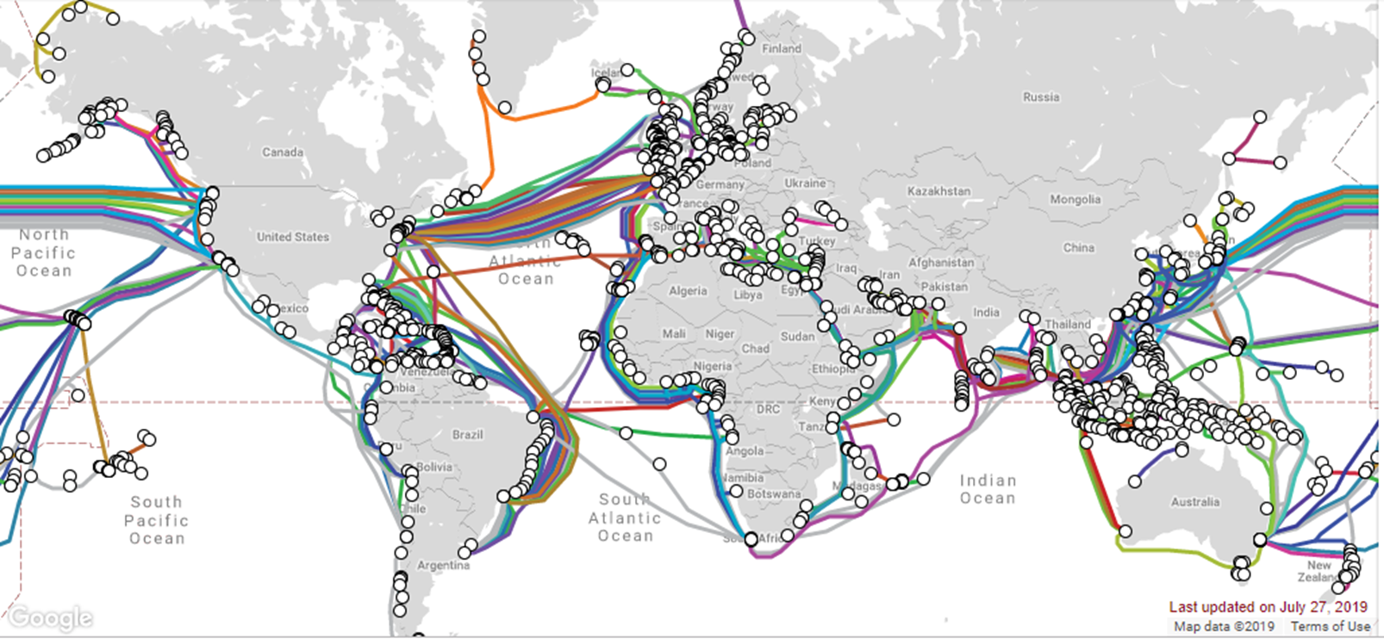
Submarine Cable Map
Cloud data is stored off-site, and largely travels through submarine cables that are laid at the bottom of the ocean. So the cloud is not in the air as we might think, but underwater.
https://www.submarinecablemap.com/

Slide 31
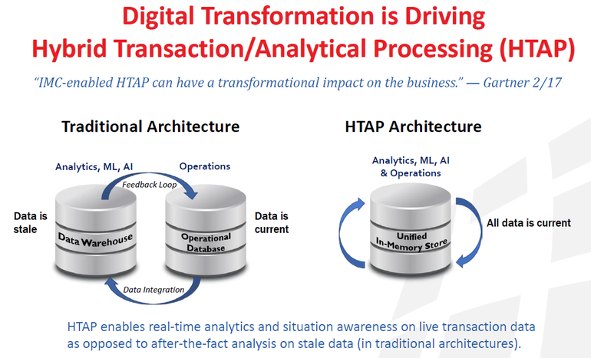

Slide 32
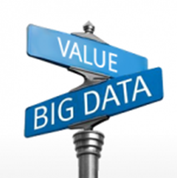
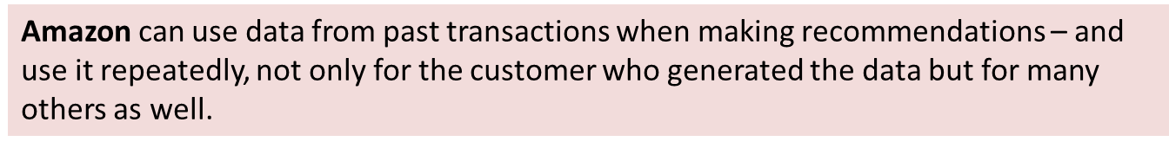
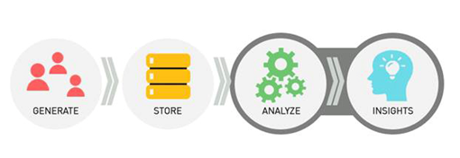
Value of Big Data
Data’s value shifts from its primary use to its potential future use.
Unlike material things, data’s value doesn’t diminish when it is used.
“Non-rivalrous” good – one person’s use of it does not impede another’s.
Transformational value
Customer delight (beyond customer satisfaction)
Competitive advantage
World-class risk management
Disruptive new business model, e.g. cloud computing
Digital disruptive companies

Slide 33
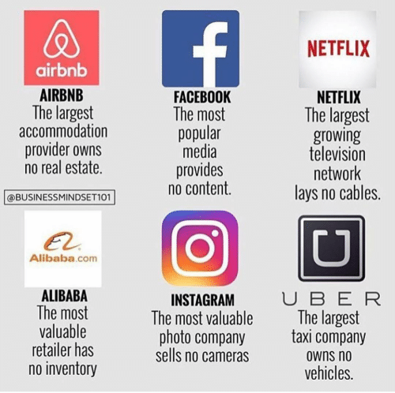
Digital Disruption
Digital disruption is the change that occurs when new digital technologies and business models affect the value proposition of existing goods and services.

Slide 34
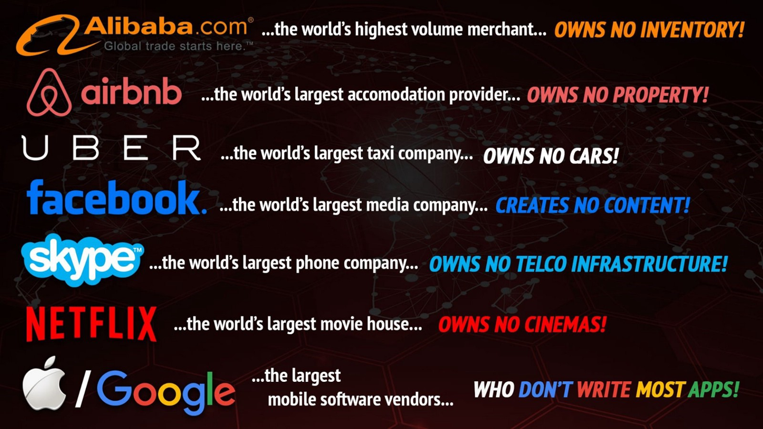

Slide 35
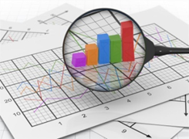
The Reuse of Data
The value in data’s reuse is good news for organizations that collect or control large datasets but currently make little use of them.
A classic example of data’s innovative reuse is search terms. Old queries can be extraordinarily valuable.
SWIFT, the global interbank system, offer GDP forecasts based on fund transfer data passing over its network.

Slide 36

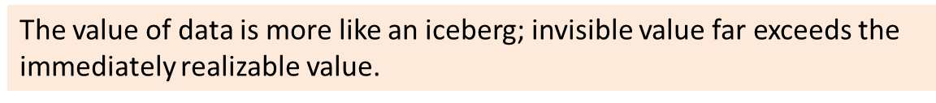
The “Option Value” of Data
This means the system takes information generated for one purpose and reuses it for another.
Primary use:
The car’s battery indicator tells when to fill gas.
Power grid usage data is for manage the stability of grid.
Secondary use:
Determine when and where to recharge, and where to build electric vehicle service stations.

Slide 37
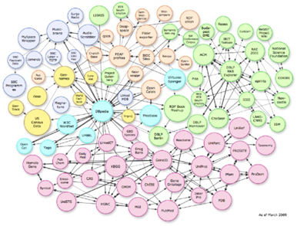
Recombinant of Data
Combining multiple (and disparate) datasets.
We can do innovative things by commingling data in new ways.
With big data, the sum is more valuable than its parts, and when we combine the sums of multiple datasets together, the sum too is worth more than its individual ingredients.
The Danish Cancer Society meshed cell-phone transaction data with socioeconomic and cancer registry files to test the influence of cell-phone use on cancer prevalence in Denmark.

Slide 38
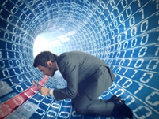
The Value of Data Exhaust
Data exhaust is another way of reuse, which treats each discrete interaction as a signal to use as feedback.
It is the mechanism behind many services like voice recognition, spam filters, language translation.
When users indicate to a voice-recognition program that it has misunderstood what they said, they in effect “train” the system to get better.
Google developed the world’s most comprehensive spell checker as an artifact of its work proposing corrections to errors in search engine queries.

Slide 39

The Value of Open Data
Government are the original gatherers of information on a mass scale. Many people call for “open government data”.
A website FlyOnTime.us shows how likely bad weather will delay flights at a particular airport, from the information amassed by the federal government.
This shows an entity that does not collect or control information flows, like search engine or big retailer, can still obtain and use data to create value.

Slide 40
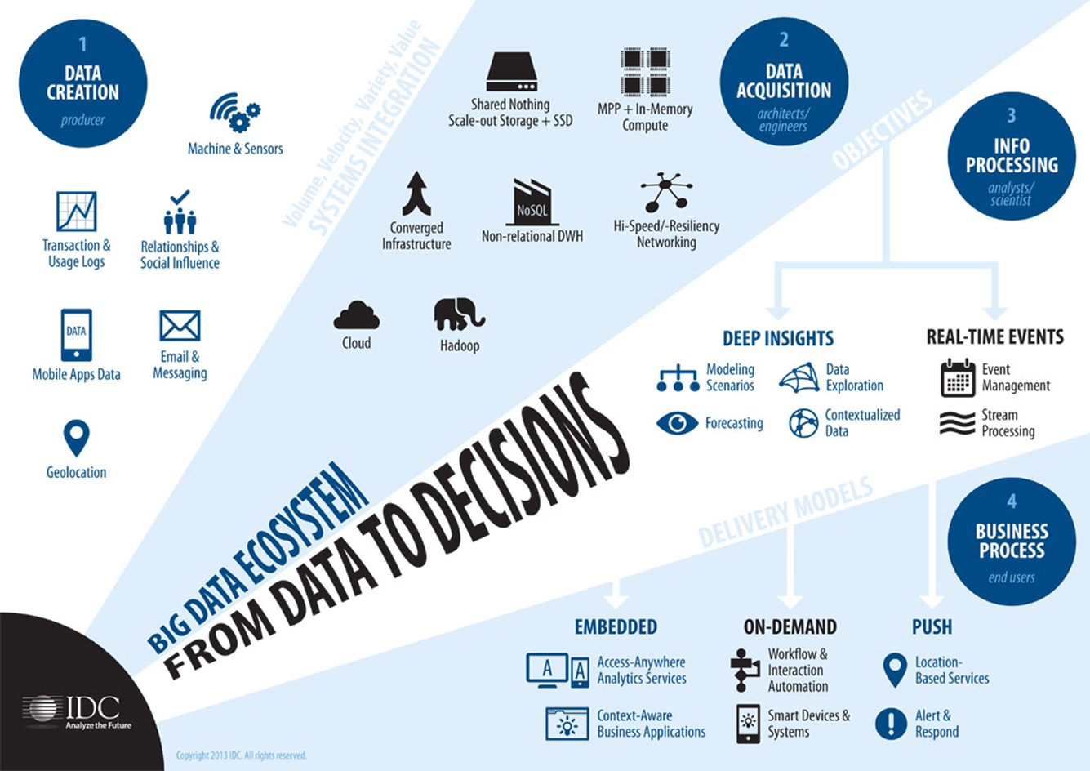
Big Data Ecosystem - From Data to Decisions

Slide 41



Big Data as Research & Scientific Topic
Figure 1: Time line of Big Data as topic of research. The dotted line represents the exponential growth curve best fitting the data represented by the blue bars. This shows the number of Big Data articles increasing faster than the best exponential fit.
Figure 2: Subject areas researching Big Data
Figure 3: Geographical Distribution of Big Data papers

Slide 42

Journals

Slide 43


Slide 44
Conferences
The IEEE 2016 - International Congress on Big Data (BigData 2016)
Big Data TechCon
ASE International Conference on Big Data Science and Computing
Big Data Innovation Summit
Global Big Data Conference

Slide 45


Slide 46


Slide 47
Opportunities & Benefits of Big Data Utilization
Make better fact-based decision faster.
Improved customer experience.
Increased sales.
New product innovations.
Reduced risk
More efficient operations.
Higher quality products and services.

Slide 48

Challenges in Handling Big Data
The Bottleneck is in technology
New architecture, algorithms, techniques are needed.
Also in technical skills
Experts in using the new technology and dealing with big data.

Slide 49

Source - http://www.forbes.com/sites/gilpress/2014/09/10/new-surveys-on-big-data-big-decisions-analysis-and-intuition/

Slide 50
Data Drivenness

Slide 51

“Without data, all anyone has are opinions. Data elevates the probability that you’ll make the right decision.”
W. Edwards Deming
“Data driven means that progress in an activity is compelled by data rather than by intuition or personal experience. It is often labeled as the business jargon for what scientists call evidence based decision making”
Wikipedia 2015-02-02

Slide 52


Data-driven Decision Making
Data-driven decision making refers to the practice of basing decisions on the analysis of data (i.e. ‘learning from data’), rather than purely on gut feeling and intuition.

Slide 53
What Makes an Organization Data-Driven?
Prerequisite #1
An organization must be collecting data.
Prerequisite #2
Data must be accessible and queryable.
Prerequisite #3
People with skills to use the data, extract the right data and use that data to inform next steps.

Slide 54



What Makes an Organization Data-Driven?
Having lots of reports?
Having lots of alerts?
Necessary but not sufficient.
Need causal explanation (why Q),
Need analysis.
Having lots of dashboards?
Source: Carl Anderson, Creating a Data-Driven Organization

Slide 55

From Reporting , Alerting to Analysis
To be data driven – must have analytics

Slide 56

Framework for Understanding Analytics
Only by understanding why something happened you can formulate a plan or set of recommendations (E).
E) and F) are truly data-driven but if and only if the information is acted upon

Slide 57

Analytics Value Chain

Slide 58

Analytics Maturity
BA
BI

Slide 59








Four Predominant Information Categories

Slide 60



Slide 61

https://www.slideshare.net/CarlAnderson4/ddo-seattle

Slide 62




Data-driven World
Airbus 380
1 billion line of code
each engine generate 10 TB every 30 min
640TB per Flight
12 TB of data per day
1TB of data everyday
What we do with these amount of data?

Slide 63


Data driven culture
https://www.slideshare.net/CarlAnderson4/ddo-seattle

Slide 64
Data Science versus Statistics
Statistics traditionally is concerned with analyzing primary (e.g. experimental) data that have been collected to explain and check the validity of specific existing ideas (hypotheses).
Primary data analysis or top-down (explanatory and confirmatory) analysis.
‘Idea (hypothesis) evaluation or testing’ .
Data science (or data mining), on the other hand, typically is concerned with analyzing secondary (e.g. observational or ‘found’) data that have been collected for other reasons (and not ‘under control’ of the investigator) to create new ideas (hypotheses).
Secondary data analysis or bottom-up (exploratory and predictive) analysis.
‘Idea (hypothesis) generation’

Slide 65

Data overtake algorithm!

Slide 66

More Data or Better Models

Slide 67

The figure shows that, for the given problem, very different algorithms perform virtually the same. however, adding more examples (words) to the training set monotonically increases the accuracy of the model.

Slide 68

As the amount of data available increased, the % of data organizations can process is decreased. Thus creates a “blind zone” – an uncertainty concerning the value of all captured and yet-unexplored data.

Slide 69

Harnessing Big Data
OLTP: Online Transaction Processing (DBMSs)
OLAP: Online Analytical Processing (Data Warehousing)
RTAP: Real-Time Analytics Processing (Big Data Architecture & technology)

Slide 70

Becoming a data-driven company is a useful first step, but is based on building tools, abilities, and a culture that acts on data, instead of really making an internal transformation around data.
Use your data-driven experiences to move up to a higher lever and become a data-centric company, putting your data at the core of your organization.

Slide 71
We’ve talked about data-driven businesses for some time and many organizations now claim to be data-driven, making decisions which are often fully automated, based on data rather than simply informed by the figures in reports. Recent research shows that 86 per cent of businesses claim to either have a data-driven strategy in place already or they plan to implement one in the next five years.
The next evolution will be towards data-centricity. This is where an absolute commitment to high-quality centralized data forms the core of business operations. Tools are built around data, rather than the current status quo of building tools that act upon the organizational data siloes. It becomes less about collecting and hoarding data – the Big Data mentality – and more about acting on data intelligently.
Reference:
https://www.dataversity.net/predictions-2019-data-analytics-trends-to-watch/

Slide 72


Summary
Think Big
Start Small
Scale Up
Fail Fast & Cheaply
Start with experimentation
Focus on Value

Slide 73


Big data is better data – Kenneth Cukier, TEDSalon Berlin
https://www.ted.com/talks/kenneth_cukier_big_data_is_better_data?language=en

Slide 74

References
Mayer-Schönberger, V., & Cukier, K. (2013). Big data: A revolution that will transform how we live, work, and think. Houghton Mifflin Harcourt.
Research Trends- Special Issue on Big Data

Slide 75


Slide 76
Discussion Qs
Identify TWO data-driven activities.
To be data-driven requires an predominant data culture. Discuss what data culture is and how to build a data culture in an organization.
Provide ONE example of datafication.
Debate on the following statement, “Big data brings big value for companies.”

